Slide 1
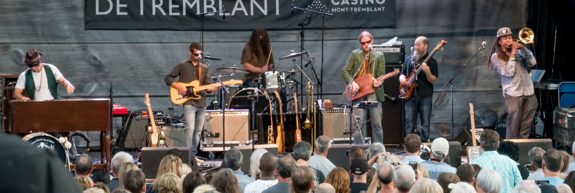
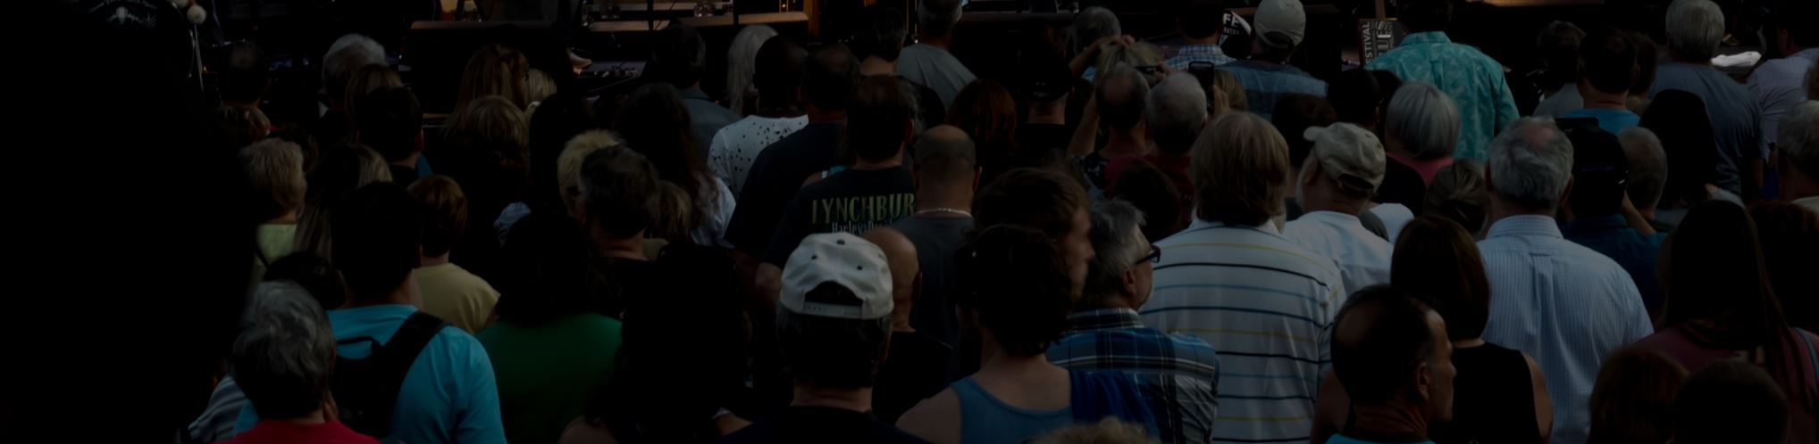
Leading Into Our Futures
Stephen Downes - Mont Tremblant, Quebec - July 8, 2017
Colleges and Institutes Canada Leadership Institutes
http://www.downes.ca/presentation/471

Slide 2
Leading Into Our Futures
This is a design exercise
We will consider a series of concepts and issues and engage in a series of ‘what would you do?’ exercises. The Scenario: what if education were a startup? How would we design the system from scratch?
Objectives of this approach
To emphasize the complexity of the topic - we are not looking at simple on-off choices
To provide experience in distributed and non-consensual decision-making, ie.
  Each person retains their own perspective
  The output of the workshop is emergent from individual decisions
  This outcome is a complex pattern, not simple statements

Slide 3
Schedule
9:15 - drivers and attractors
9:35 - stakeholders and benefits
9:55 - affordances
10:15 - break
10:30 - impact
11:00 - services and trends
11:30 - designing the future institution

Slide 4
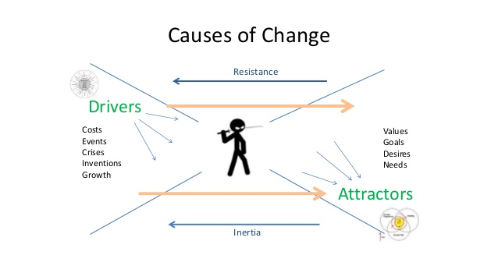
Drivers and Attractors
Concept: do we shape change, or react to it? Do we work toward something, or work to avoid something?

Slide 5
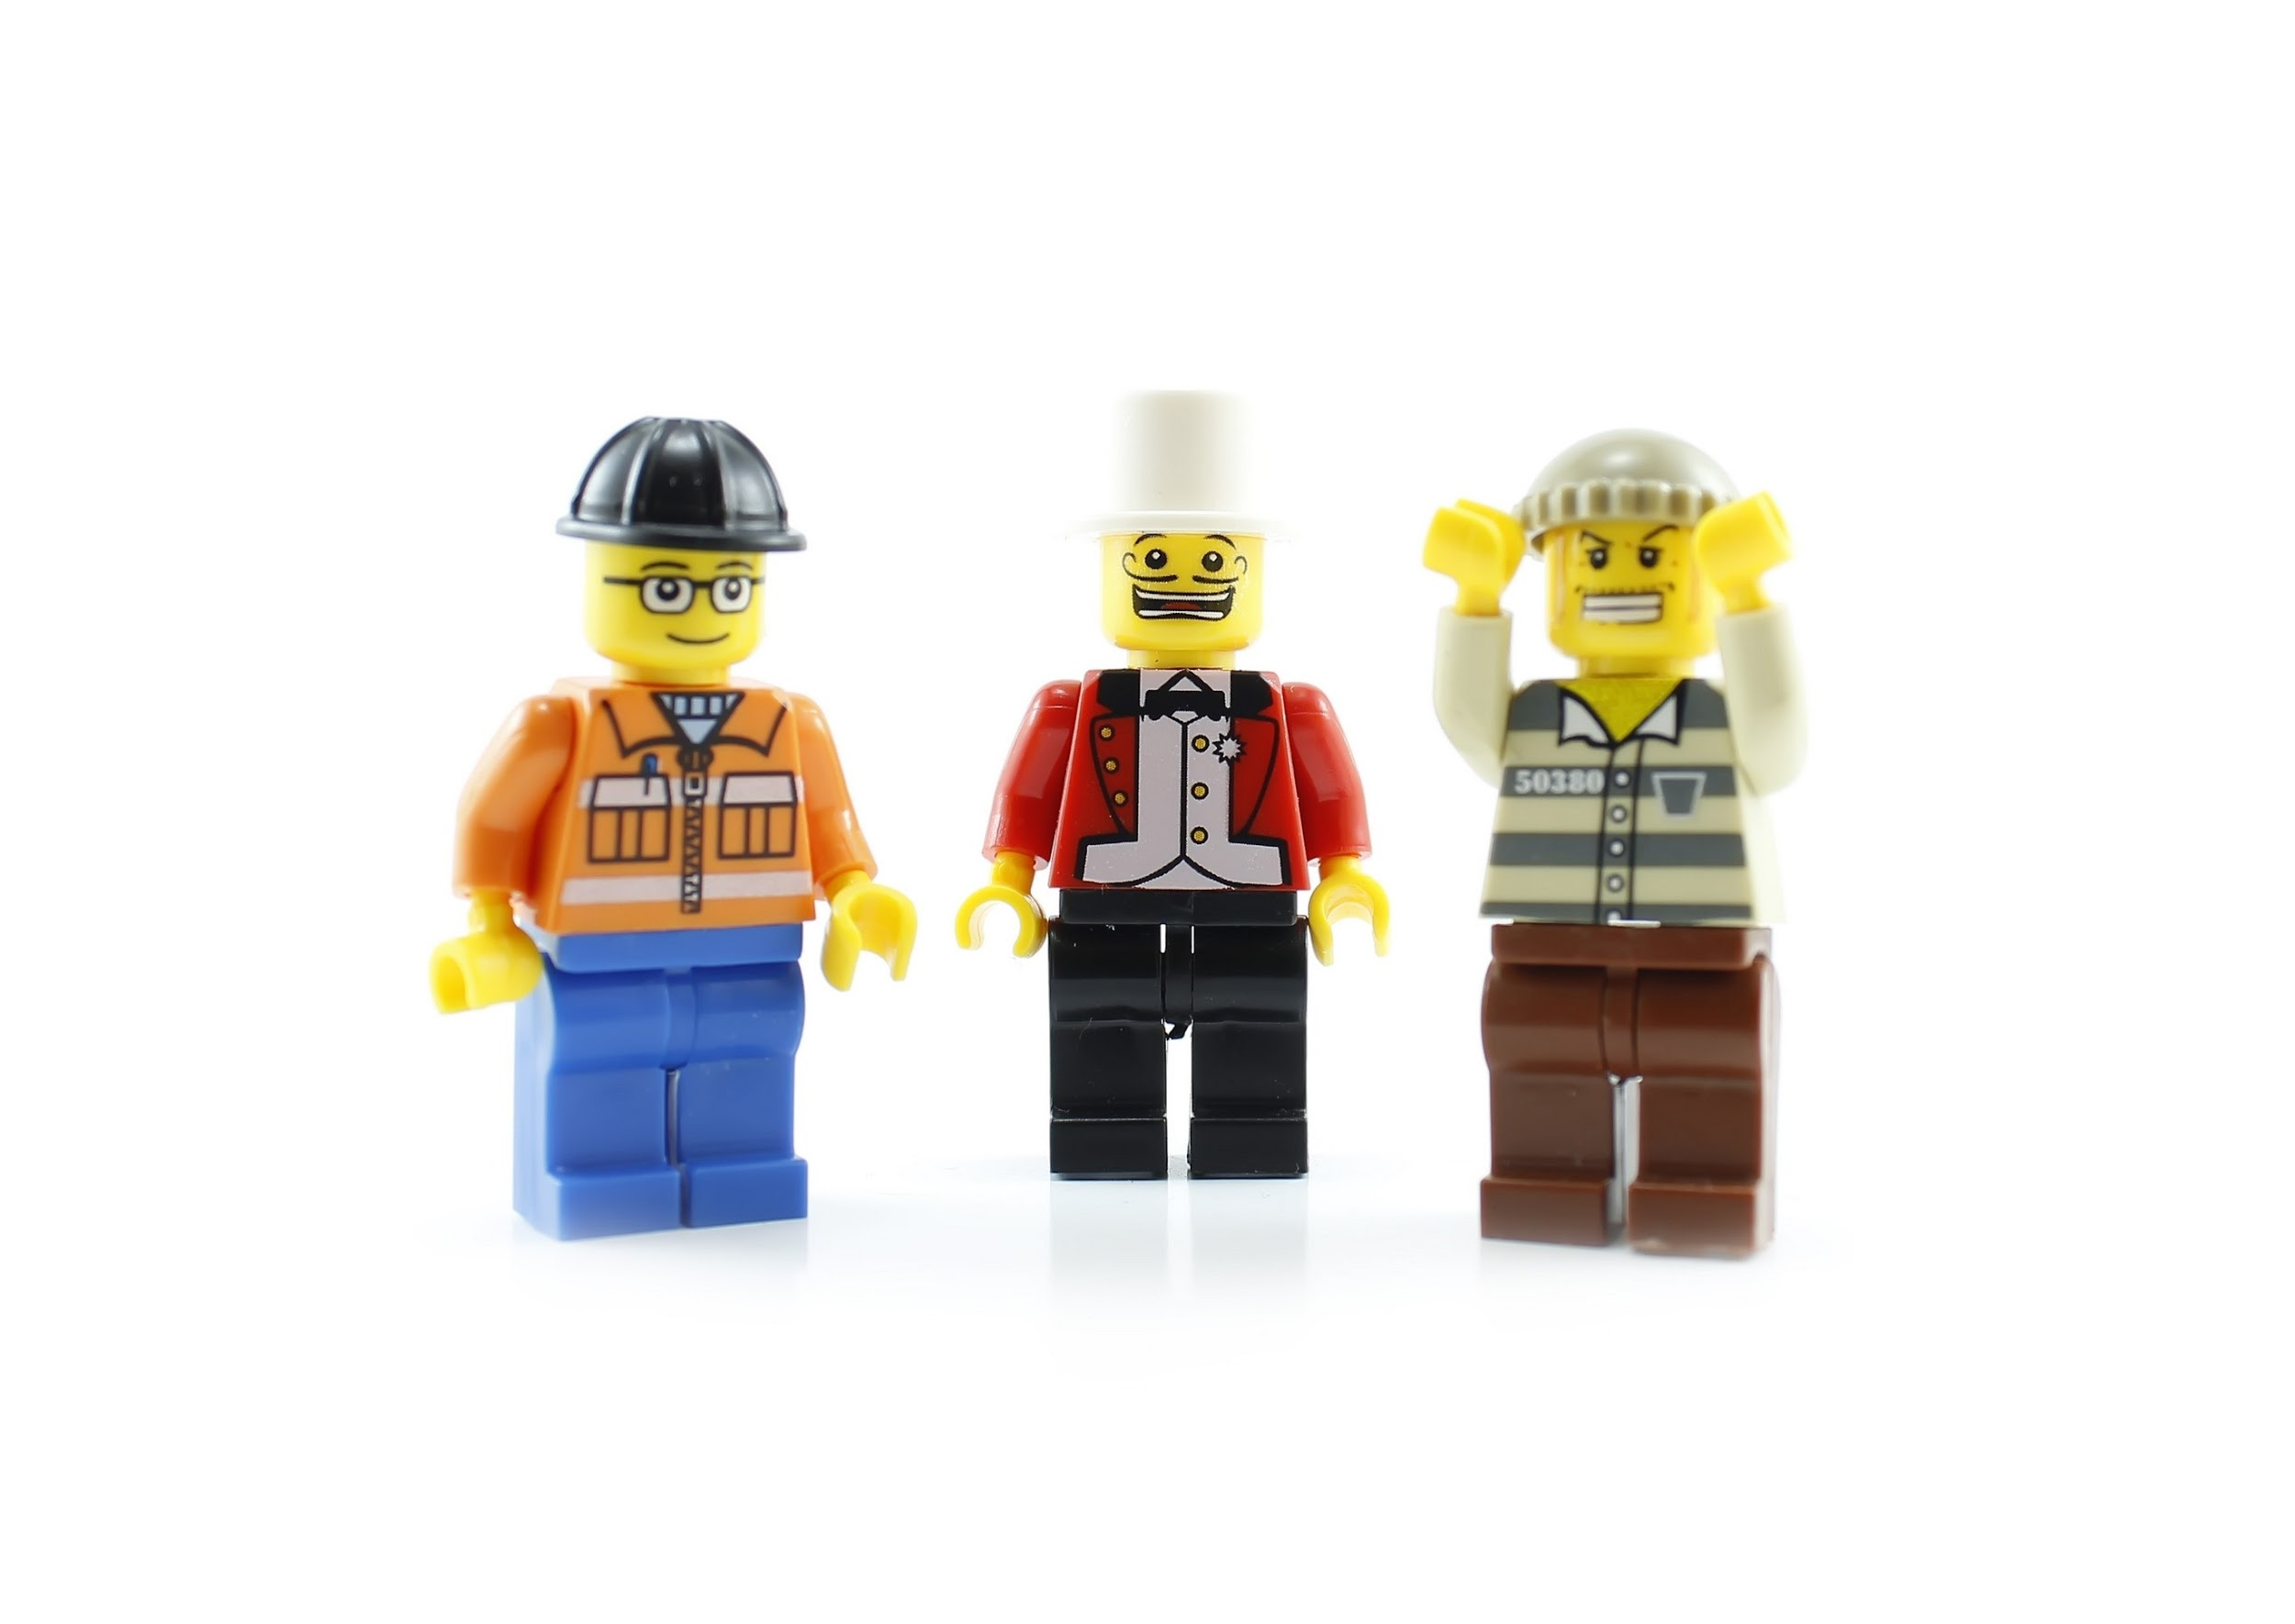
Activity
Core questions:
What is driving change in our field? (eg., tech, economy, climate change, etc)
What are the attractors in our field (learning, prosperity, etc)
Method - groups of two, in two stages - discuss and then select one driver; one attractor (record on index card, place as cluster on wall)

Slide 6
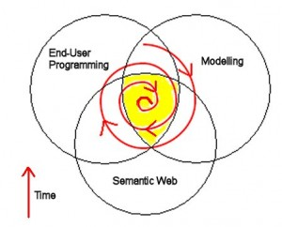
Stakeholders and Benefits
Concept: why are we doing what we do? If we assume directionality, toward what are we working?
Core questions:
Who do we serve? (students, industry, governments, society, etc) - but we want to focus - ‘government’ eg. is too vague, do we mean ‘support the party in power’, ‘further a policy agenda’, ‘work for broad social goods’ etc?
What is the benefit - not just the good that is produced (graduates, certifications, etc) but the value that is produced (jobs, growth, prosperity)
Jobs
Growth
Values

Slide 7
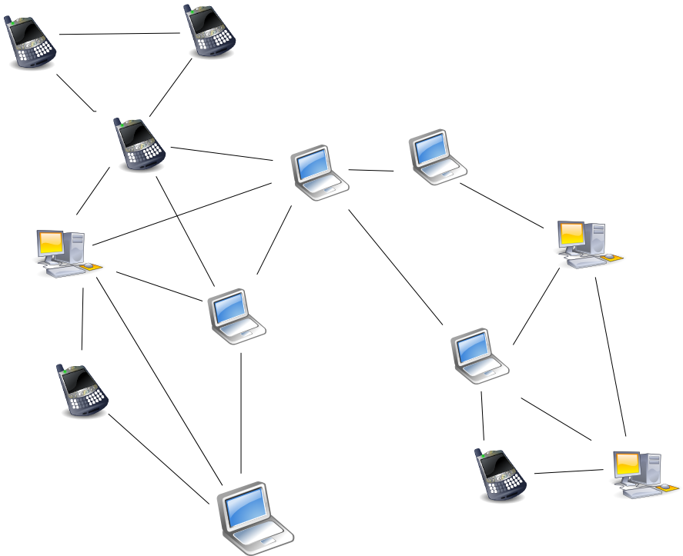
Activity
Method - groups of two, in two stages - discuss and then select one stakeholder; one benefit (record on index card, place as cluster on wall)
Reflect: do we see any connections between the cards on the wall? - draw connections with string or thread

Slide 8
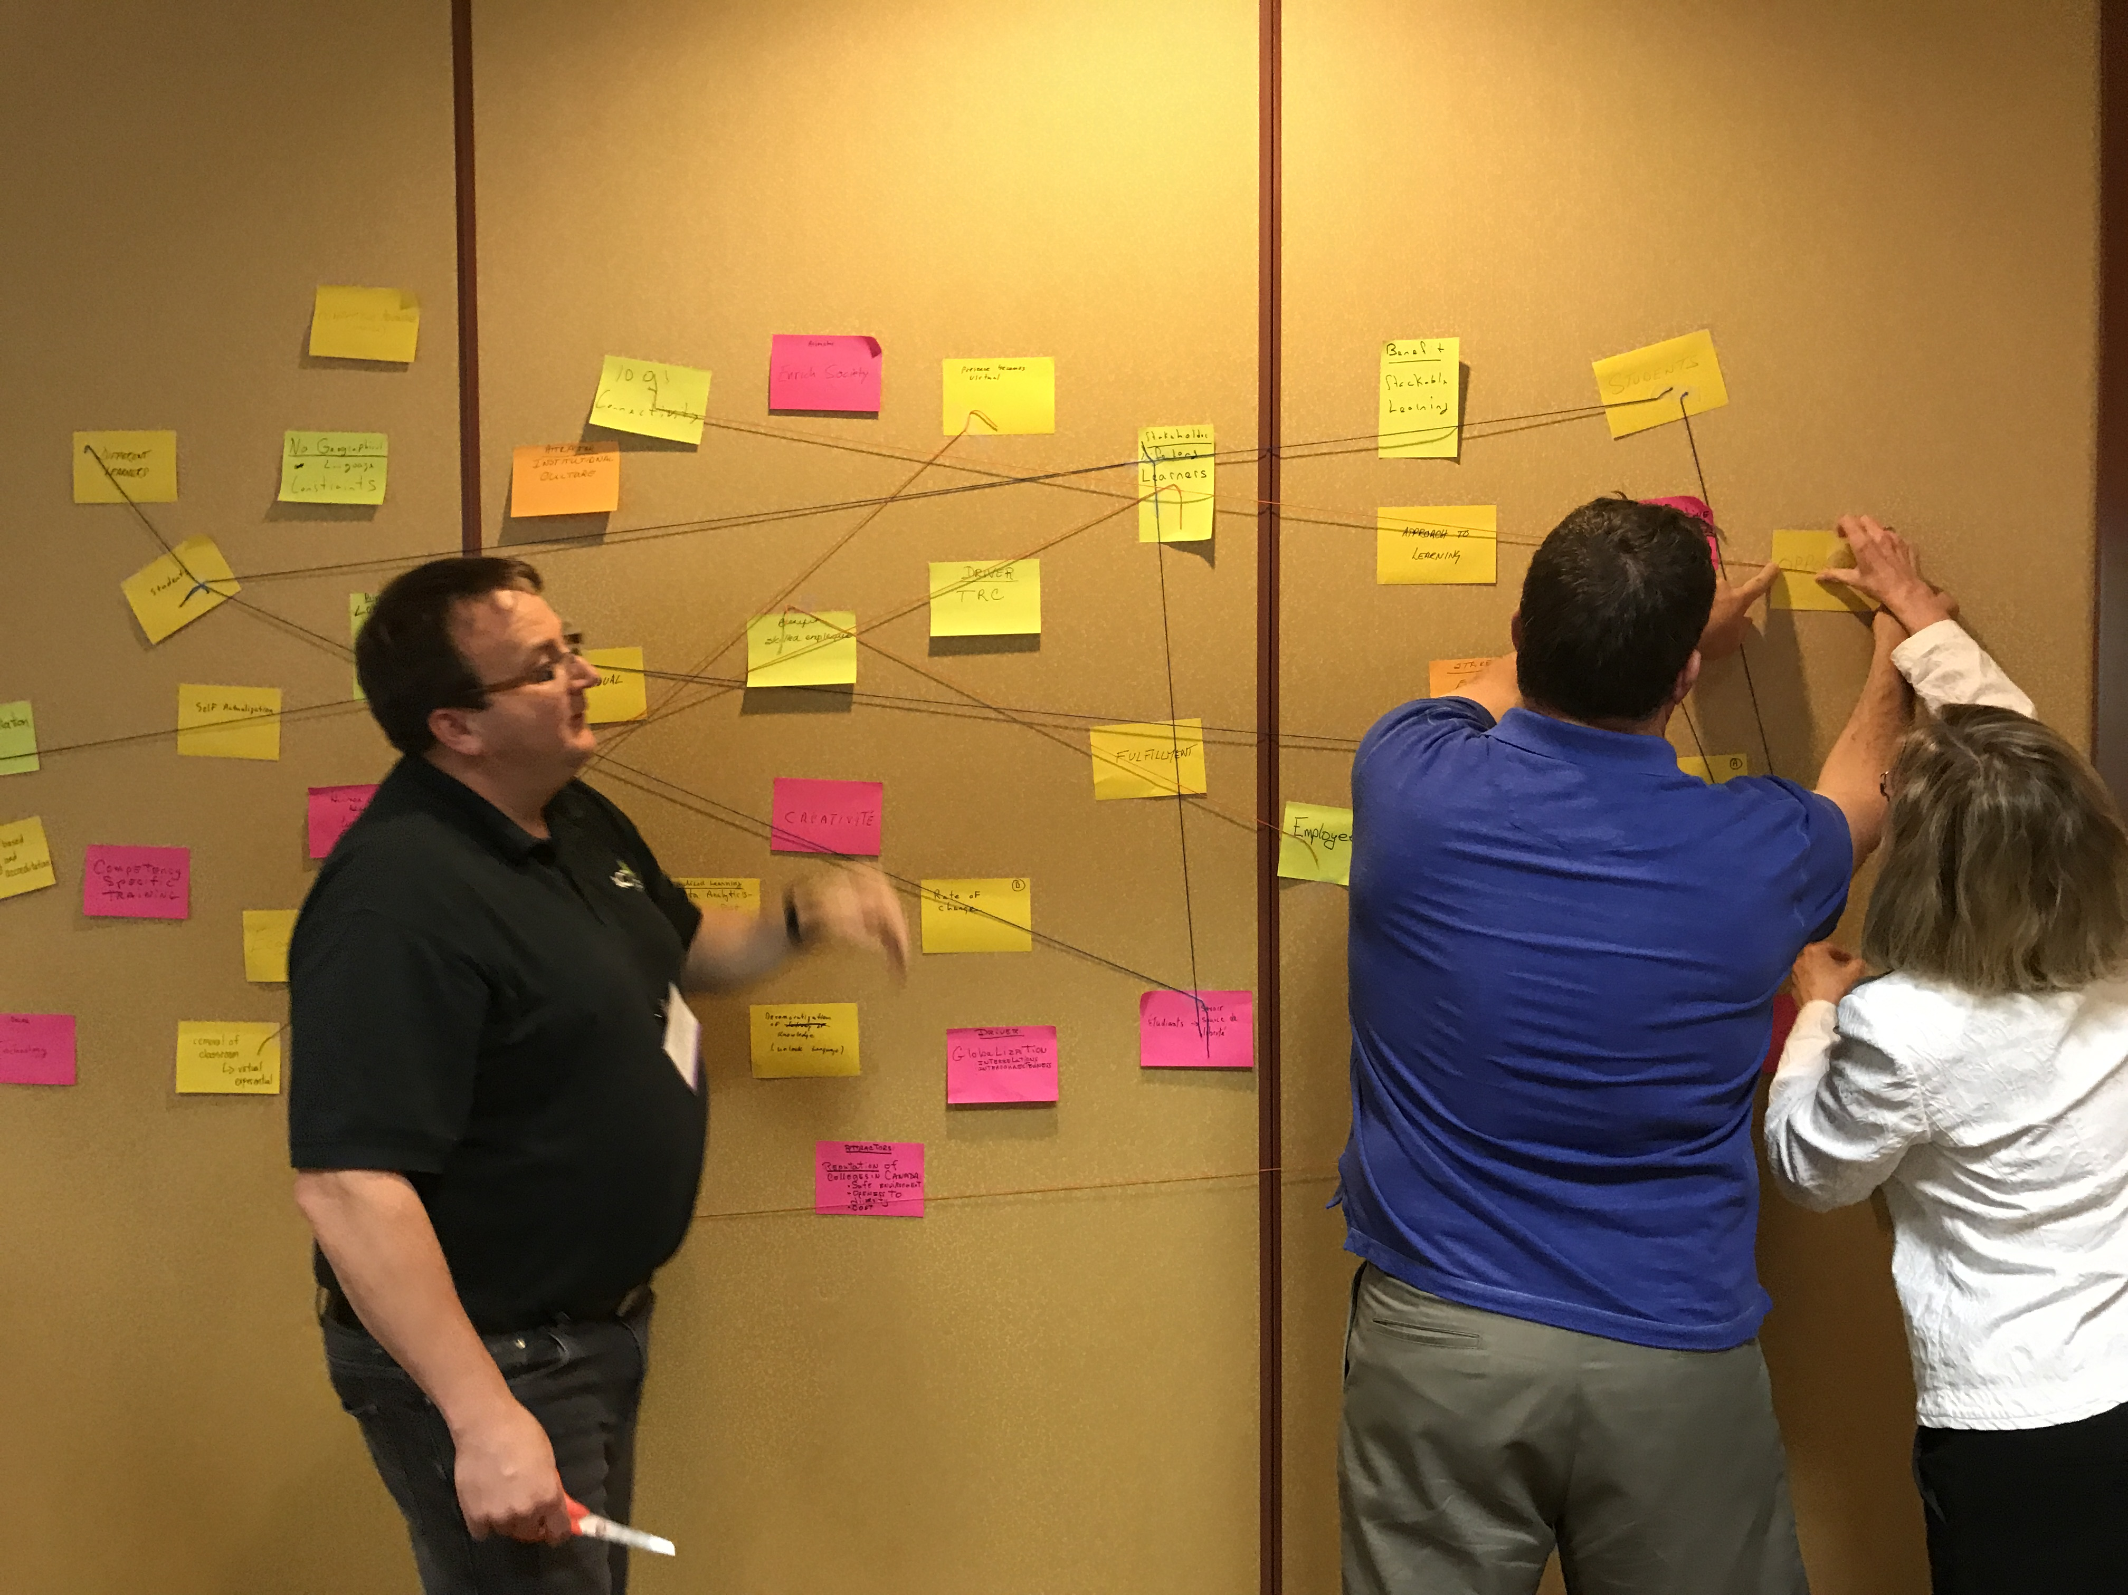
Building the Diagram

Slide 9
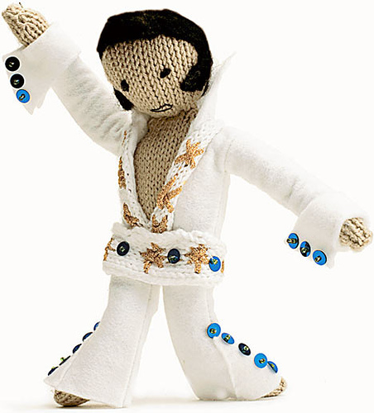
Affordances
Concept: what new things will we be able to do?
Core questions:
How is technology changing?
    bandwidth, computing power, social media, internet of things, new interfaces and VR, analytics, etc
What new things can we do?
    Immersion and simulating, making, predicting, analyzing...

Slide 10
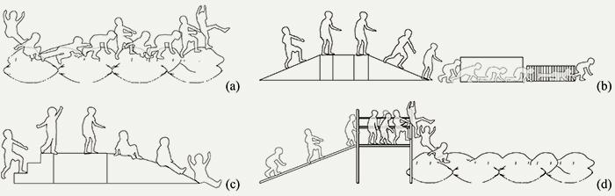
Activity
Method - in groups of 4 or 5, make an inventory of 10 or so key new affordances - give each member of the group a copy

Slide 11
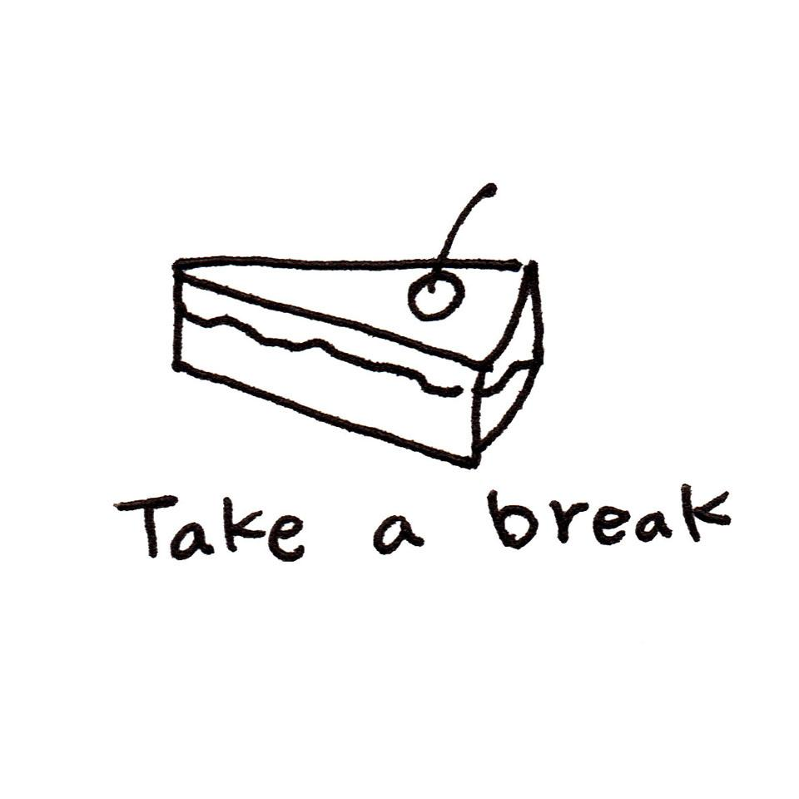
Break

Slide 12
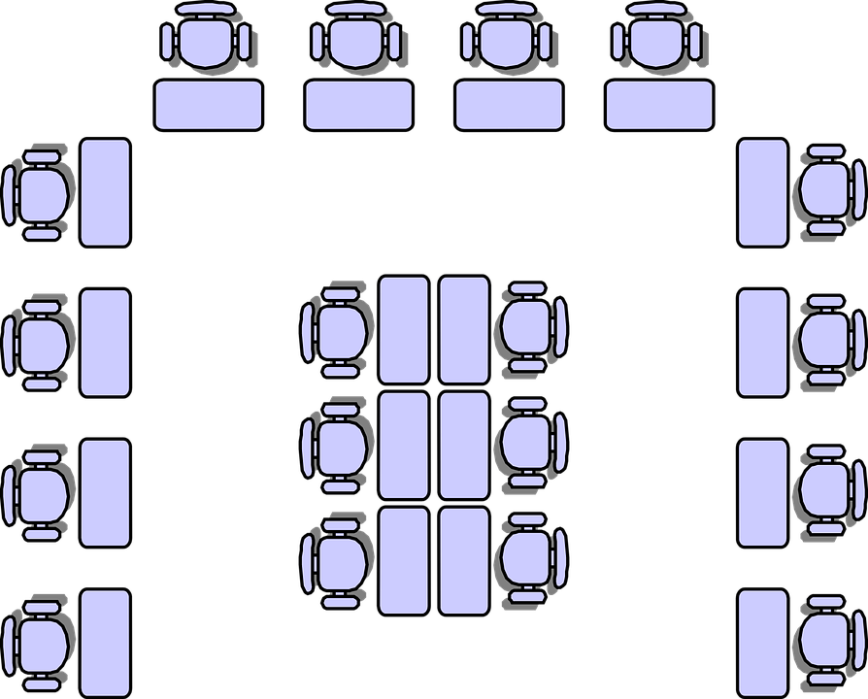
Impact
Concept - how will ‘normal education’ change as a result of new affordances?
classrooms
cohorts
resources (texts, etc)
assessment
credentials

Slide 13
Activity
Method - shuffle the groups - then, for each of the five items, using the affordance inventories available to the group, agree on a key change in existing practice; create an index card for each and place in the cluster of index cards on the wall
Reflection - draw connections between the existing cards on the wall and the new cards, and indicate them with string. Do we have any outliers? (ie., things not connected with string) Do we have any conflicts? Mark the connection as a conflict with an explosion icon

Slide 14
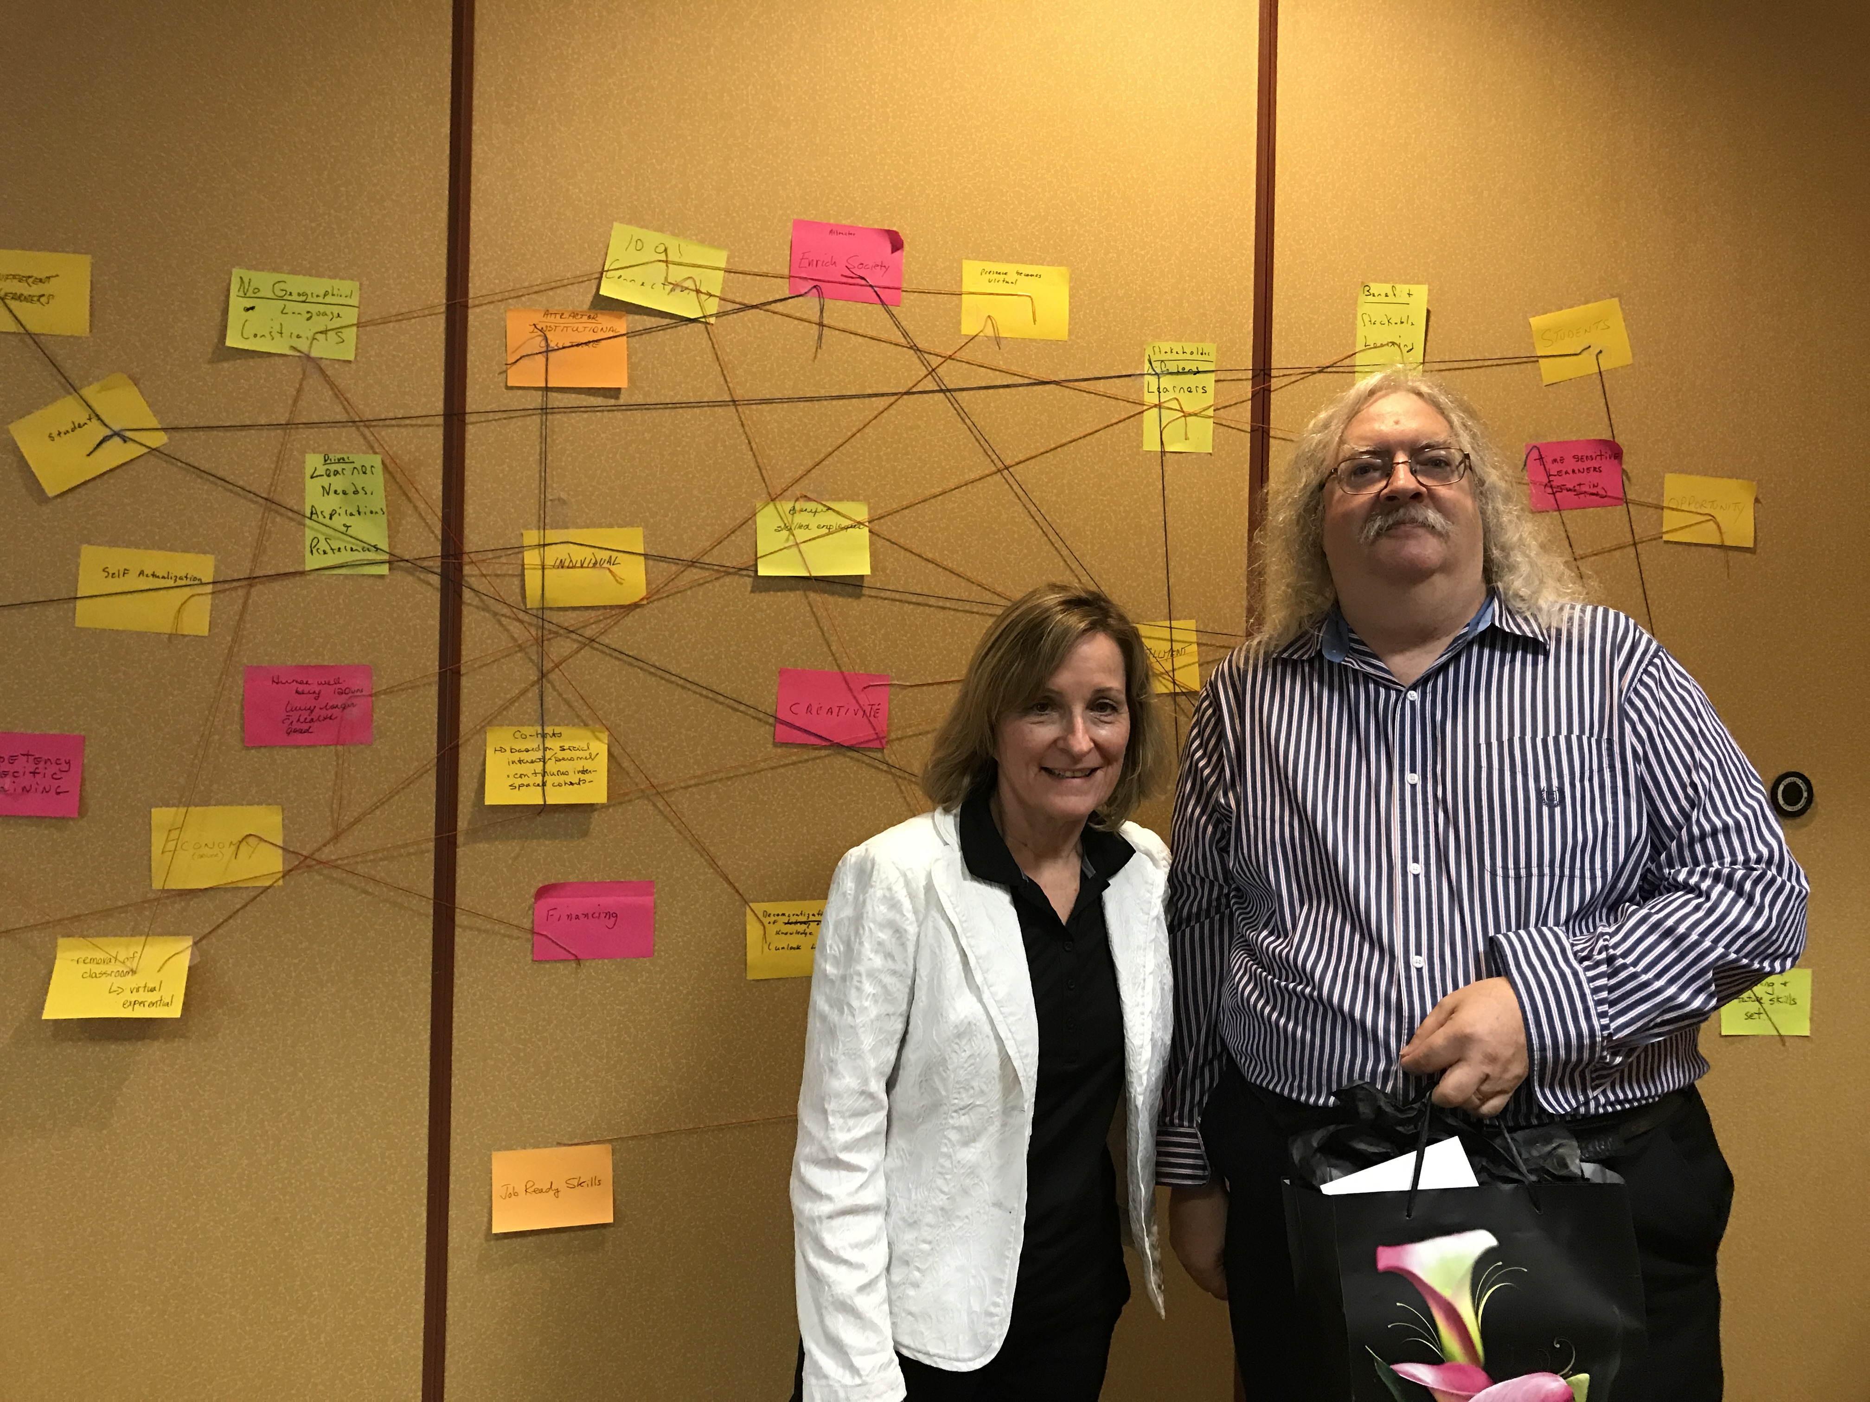
Completed Diagram

Slide 15
Services and Trends
Concept - given what we understand so far, how would we assess and/or use the major ‘trends’ being identified? (Or would you identify new services?) Here are some of the major trends:
Personalization & Predictive Analytics
Bots and automation
Virtualization & distributed networks
From medium to environment (from content to field)
more?

Slide 16
Activity
Method: in groups, for these and other trends:
Assess the trends and select one of more trends to focus on. Create an index card for that trend.
Compare the trend(s) against the cards on the wall
Can we see these trends as outcomes of what we’ve already identified? Ie., do they deliver what we’ve targeted thus far? Connect with a string.
Can we see these trends as opposing what we’ve already identified?
Reflection - draw connections between the existing cards on the wall and the new cards, and indicate them with string. Do we have any outliers? (ie., things not connected with string) Do we have any conflicts?

Slide 17

Designing the Future Institution
Concept - how would we now design the education system from the ground up...
Defining the logic model:
Stakeholders - benefits - attractors - affordances - impact - services
What is the business model? How do we sustain?
  Have we achieved greater efficiencies?
  Have we generated greater value?
  What is the nature of the value produced? (economic, personal, social, cultural…?)

Slide 18
Designing the Future Institution
Concept - how would we now design the education system from the ground up...
What is the strategy?
    How do we structure our institutions
    (or do we even have institutions)?
    What are the services and value offered
    Positioning and marketing
What are the outcomes?
    What constitutes ‘success’ in this future environment?
    How is it measured?

Slide 19
Activity
Method (Converting the Network into a System?)
In group or as individuals:
  Study the collection of cards on the wall
  Identify patterns of connectivity - this will define the logic model connecting stakeholders - benefits - attractors - affordances - impact - services
Describe inputs and outputs
  Inputs - external resources (funds, people, whatever)
  Outputs - the ‘product’ delivered by the system

Slide 20
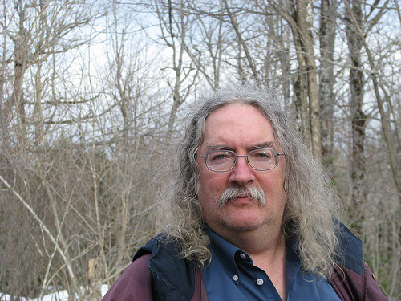
Stephen Downes
http://www.downes.ca
Moncton, Canada, 2005
http://www.downes.ca/presentation/471

